Slide 1
Logical Agents
UI VI
Mária Markošová

Slide 2
Summary from the last lecture
Game in AI, definition, one player games
Multiplayer games, simultaneous games, sequential games.
MINIMAX algorithm and zero sum games.
Alpha beta pruning.
Cut off search and evaluation functions.
Monte Carlo method and games.
Logical agents, intro.

Slide 3
Outline
Propositional KB
Inference methods in propositional knowledge base
KB written in first order logic
Inference methods in predicate KB

Slide 4
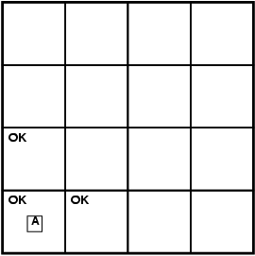
Exploring wumpus world
breeze (vánok)
stench (zápach)
(stench, breeze,glitter,bumb,scream)
(none,none,none,none,none)
(0,0,0,0,0)
Current percept

Slide 5
Logic
Logic consists of:
Formal problem describing system syntax and semantics
Theory of logical proofs and logical reasoning, rules of logical reasoning.
Logical reasoning: On the basis of logical rules and relations we derive from the known sentences the unknown ones. We are dealing with propositional logic in this part.

Slide 6
Propositional KB
Interpretation: It is an assignment of meaning to the logical symbols. In propositional logic it is a mathematical abstraction of the real world in which we know the truth values of each sentence.
Model: Mathematical abstraction of the real world in which the sentence has a value True or 1 which means true.
Example: logical sentence
Model of the sentence
1 1 1 1 1 1 0 1

Slide 7
Example: Logical reasoning by model checking (Russel, Norwig)
Let wumpus world have only pits.
A sentence a entails another sentence b if, whenever a is true, then b must also be true.

Slide 8
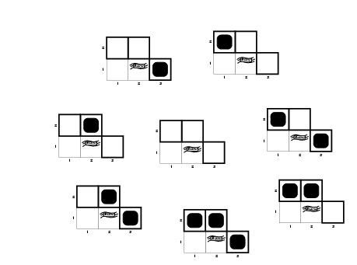
Wumpus models

Slide 9
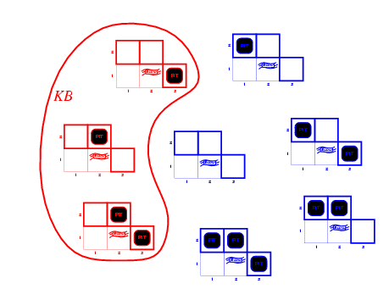
Wumpus models
KB = wumpus-world rules + observations
background KB

Slide 10
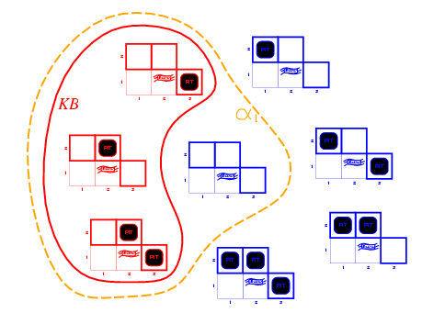
Wumpus models
[1,2]
KB = wumpus-world rules + observations
α₁ = "[1,2] is safe", KB ╞ α₁, proved by model checking

Slide 11
Wumpus models
KB = wumpus-world rules + observations

Slide 12
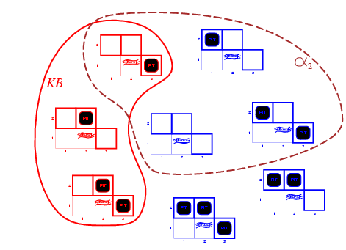
Wumpus models
[2,2]
KB = wumpus-world rules + observations
α₂ = "[2,2] is safe", KB ╞ α₂

Slide 13
Soundness and completness
Algorithm of inference (vyvodzovania) is sound (korektný) if it infers only such sentences which are entailed in the KB.
Algorithm of inference is complet if it is able to infer all sentences entailed in the KB.
If our KB has a value True in a real world , then each sentence infered by the sound method of inference is also True in a real world.

Slide 14
Propositional logic
Real world is described with a help of facts.
Example: Agent is at [1,1]
Proposition: Sentence about which one can decide whether it is true or false.
atomic sentence, atomic formula:
has no logical connection: Agent is at [1,1]
sentence, formula: in general contains at least one
logical connection: Agent is at [1,1] and wumpus is at [2,3]
Agent is at [1,1] or wumpus is at [2,3]
If Agent is at [1,1] then wumpus is at [2,3]
Agent is at [1,1] if and only if wumpus is at [2,3]

Slide 15
Syntax of the propositional logic
Syntax
symbols:
logical constants True , False
propositional symbols P, Q, R
connections , , , ,
brackets ()
unary connection
binary connections

Slide 16
Semantics of the propositional logic
Semantics defines the rules how to find a truth values of the sentences with respect to the given interpretation. Interpretation is a truth values addition to the atomic formulas.
Formula (sentence)-definition
Each propositional symbol is a formula (atomic formula)
If an expression A is a formula then also is a formula.
If expressions A, B are formulas , then , , , are formulas.
Nothing else in a formula

Slide 17
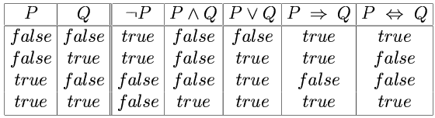
Rules for truth values derivation
Modus ponens

Slide 18
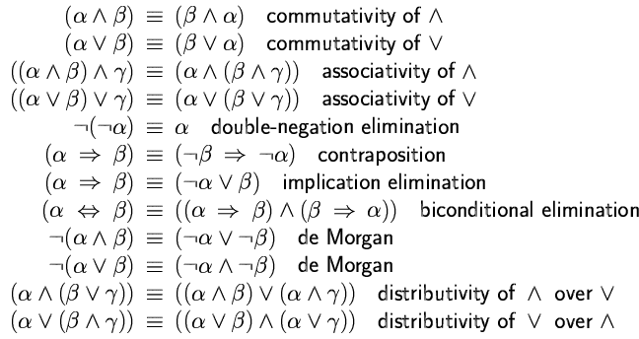
Logical equivalence
Two sentences are logically equivalent iff true in same models: α ≡ ß iff α╞ β and β╞ α

Slide 19
Inference rules of the propositional logic
Modus ponens : If formulas A and are true, then B is true p
Modus tollens :
Simplification: If conjuction is true, then all conjucts are true

Slide 20
Conjunction introduction : If are true, then their conjunction is true .
Adition: If formula is true, then its disjunction with all formulas is true.
Double negation elimination: If some formula is negated twice one gets the same formula.

Slide 21
Unit resolution:
Jednotková rezolvencia (unit resolution)
General unit resolution:
is a negation of Full resolution

Slide 22
Inference in the propositional logic – exam example
1
2
3
4
5
6
7
8
9
Let us suppose this is our KB at the moment and we want to infer what is possible using the rules. All sentences in KB are true.
assumption 1 simplification
assumption 1 simplification
result 5 and modus tollens on the assumption 2
result 7 and modus ponens on the asumption 3
result 8 and modus ponens on assumption 4

Slide 23
Normal forms
Resolution rules are applicable on the conjunction of disjunctions (normal forms).
If KB has not such structure, what to do?
Each sentence in the propositional logic is logically equivalent to the conjunction of disjunctions : CNF (conjunctive normal form)

Slide 24
CNF algorithm
input : formula a , output CNF of the formula a
algorithm:
1. Subformulas are replaced by
2. are replaced by
3. Rewrite
4. Distribution rules for and :
5. Replace redundancies such as is replaced by X.

Slide 25
Clause
Literal: formula or its negation, here are three literals
Clause; disjunction of literals, here are three clauses:
CNF: conjunction of clauses

Slide 26
Resolution algorithm
We want to prove that = . We shal prove it with a help of contradiction by showing that cannot be satisfied.
Convert to the CNF form .
Do resolution and add new sentences into KB.
Process finishes if: - there are no new expressions we can add, then
= sentence is not entailed in KB
- we get an empty clause, = then sentence
is entailed in KB

Slide 27
Example
We want to prove, that there is no pit at [1,2] position α = ¬P_{1,2}
KB = (B_{1,1} ⇔ (P_{1,2}∨ P_{2,1})) ∧¬ B_{1,1} α = ¬P_{1,2}
Ad a negation : (B_{1,1} ⇔ (P_{1,2}∨ P_{2,1})) ∧¬ B_{1,1} ∧ P_{1,2} ¬α
Rewrite 1. to the CNF form:
Use the resolution process.

Slide 28
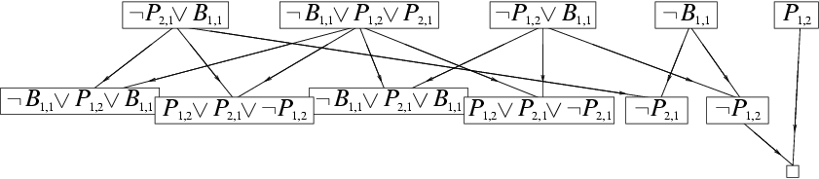
Resolution process example
KB = (B_{1,1} ⇔ (P_{1,2}∨ P_{2,1})) ∧¬ B_{1,1} α = ¬P_{1,2}
negation
True
empty clause
Redundant steps

Slide 29
Horn clauses
Horn clause: disjunction of literals where at most one of them is positive.
Example:
Agent in the wumpus world is not at the position [1,1] or agent does not feel breeze or breeze is at the position [1,1].
Agent does not feel breeze
Agent is not localized at the position [1,1].

Slide 30
Why Horn clauses?
Each Horn clause can be written as an implication. At the assumption side is a conjunction of initially negative literals and at the conclusion side is a positive literal.
Príklad:

Slide 31
2. Clause is more readable as an implication.
Agent is not at the position [1,1], or agent does not feel breeze, or breeze is at [1,1].
If agent is at [1,1] and feels breeze then there is breeze at [1,1].
Our knowledges about reality are often in the form of implications

Slide 32
Inference in KB containing Horn clauses can be done very effectively, in a linear time with respect to the input:
forward chaining algorithm
backward chaining algorithm

Slide 33
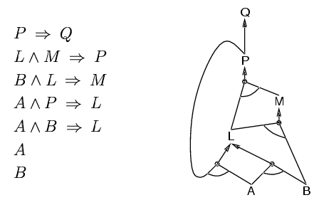
Forward chaining Can we infer Q from our KB? Is Q true in our KB?
Idea: fire any rule whose premises are satisfied in the KB,
add its conclusion to the KB, until query is found
KB
Modus ponens
Modus ponens
Modus ponens
L
M
P
Q

Slide 34
Linearity of forward chaining (intuitively):
KB: is true
Start with fact A (atomic formula), it is true.
Infer B using modus ponens. Use and elimination. Remove A from all formulas. There is no A in KB any more.
Ad inferred B into KB.
Repeat from 2. with new facts, atomic formulas (B), remove these facts from all formulas using and elimination rule.
From above steps is clear, that algorithm runs KB as many times only, as many facts is in KB.

Slide 35
Backward chaining: Is hypothesis, that Q is true valid?
We have a literal Q. We do not know, whether it is true.
We seek such implications in KB, which implies Q.
If all premises of this implications are true, then Q is true.
Implication is true, in its assumption is P
Implication is true, in its assumption are L, M and in result is P
Implications are true, in the assumption parts are L, B, A, P and in the result M, L
Implication is true, in the assumption are A, B and in the result is L. A., B are also facts which are true, from this point we start forward chaining and we prove Q .
Notes:
Implikacia je pravdiva, ked B je pravdive. Teda, to co je v hlave, musi byt pravda.

Slide 36
Forward vs. backward chaining
FC is data-driven.
Can infer a lot of facts not connected with Q.
BC is goal-driven, making only those steps which support goal.
Complexity of BC can be thus better then that of FC.

Slide 37
Logical agent in the wumpus world
KB of the agent:
Should be written for all possible concrete values of x and y.
There is only one wumpus W in the environment
There at least one wumpus W in the environment.
For each two squares at least one is without W
155 such sentences

Slide 38
First-order logic, FOL
In the propositional logic the world is described by the facts
In the FOL (as in the natural language) the world is supposed to consist of
Objects: people, houses, numbers, colours, …
Relations, properties: red, round, brother of, greater then, part of …
Functions: father of somebody, the best friend, one unit greater then, plus, …
FOL has better expressivity then propositional logic, is closer to the natural language

Slide 39
Syntax
Individuum variables: x, y, z..... denotes unspecified objects, they can have value from the certain domain
Predicate symbols: P, Q, R,.... denotes properties of the objects and relations between objects
Constants a,b,c....they play the role of the name of the individuals, specify them : Peter, Jan, 2,3,5
Functional symbols f,g,h, also can name, specify the individuum: , head(x)
Logical symbols

Slide 40
Predicate:
n – ary relation expressing the property of the object or relation among
the objects. Adds the truth value to the object.
unary predicate - describes the property
binary, ternary, ... n-ary predicate – expresses relations
among objects.
Arity of predicates
Arity is changing by the concretization, giving valuo to the variables.
x is taller then y, arity 2
Jozo is taller then y, arity 1
Jozo is taller then Fero, arity 0

Slide 41
Arity of the functions
Example:
Number 2 is even. If the positive integer is even, then its successor is odd.
Successor of the number two is odd.
Predicate: P(x) ; x is even number , Q(x) ; x is odd number
Function: f(x)=x+1 ; returns the successor of x
Domain: positive integers

Slide 42
Difference between the predicate and the function
Predicate: n-ary predicate P is a mapping of
which each of the n- tuple from the domain D
relates the truth value.
Function: Function f is a mapping of
which each of the n-tuple from the domain D
relates another object from D.

Slide 43
Terms:
More completely defines the name of the individuum
Variables and constants are terms.
If f is a functional symbol and are terms, then also is a term.
3. Nothing else is a term.
Atomic formula:
If P is n-ary predicate symbol and are terms, then the expression is an atomic formula.
Nothing else is an atomic formula.

Slide 44
Formula:
Each atomic formula is a formula.
If , are formulas and x is a variable, then the expressions as
are formulas.
There are no other formulas, then those created by the above mentioned rules.

Slide 45
Inference in the FOL KB
Reduce FOL KB to propositional KB and use the previous methods.
2. Generalized Modus ponens.
3. Generalized forward and backward chaining.
4. Generalized resolution.
Methods:
1. Substitution.
2. Unification.

Slide 46
I. Reduction to the propositional KB
FOL KB is transformed to the propositional KB with a
help of substitution.
Substitution:
in the sentence alpha substitution is made.
KB

Slide 47
We need to unify the formulas.
That means to find a substitution, which makes two atomic formulas identical.
Substitution unifies King(x) and King(John).

Slide 48
universal instantiation
Example
Our KB
facts
function
Because the sentence holds for all x, the sentence has universal quantifier, we have to make the concretization with all possible facts from the current KB.

Slide 50

2. Existential instantiation :
The sentence with existence quantifier tells, that there exists an object fulfilling the condition. Instantiation gives a name to the object. This name cannot be used again.
Aplied only once! After the application, the sentence with the existence quantifier is removed from the KB.
Example
Our KB
,Crown($C_{2}$)
is a Scolem constant.

Slide 51
II. Generalized Modus Ponens
Exact formulation- generalized Modus ponens
Atomic sentence
Substitution is such, that

Slide 52
Example
Let:
Then :
Infer with a help of substitution

Slide 53
More complex example ( Russell, Norwig)
Sentences:
"It is illegal for a UK student to sell Coke." "Bob is an UK student." "Everyone sells some Coke."
We want to know:
„Is Bob criminal?“

Slide 54
KB:
1. (x, y) Student(x) ^ Coke(y) ^ Sells(x,y) => Criminal(x) 2. Student(Bob), Coke(COKE1), 3. x y Student(x) ^ Coke(y) ^ Sells(x,y)
Inference: From 3. by general instantanation
4. y Student(Bob) ^ Coke(y) ^ Sells(Bob,y)
From 4. by existence instantanation
5. Student(Bob) ^ Coke(COKE1) ^ Sells(Bob,COKE1)
From 1. and 5. by Modus ponens
6. Criminal (Bob)

Slide 55
Exam example
Slytherin is a school.
Griffindor is a school.
Hufflepuf is a school.
If the student studies on the school and has a wand, then he is a whizard.
Students Harry, Ron and Hermiona study on Griffindore.
Ron has a wand named Wanda.
Prove that Ron is a whizard.

Slide 56
Predicates?
School(y), HasWand(x,z), Studies(x,y), Student(x),
Wand(z), Whizard(x)
Facts?
School(Sl), School(G), School (Hp), Student(Ron), Wand(Wanda), HasWand(Ron,Wanda), Studies(Ron,G), Student(Hermiona), Studies(Hermiona, G), Student(Harry), Studies(Harry,G)

Slide 57
Coding the problem?
School(Sl), School(G), School(Hp)

Slide 58
Forward and backward chaining : example KB according Russell, Norwig
The law says that it is a crime for an American to sell weapons to a hostile nations. The country Nono, an enemy of America, has some missiles, and all of its missiles were sold to it by Colonel West, who is American.
Prove that Col. West is a criminal

Slide 59
IV. Forward chaining
1. American(x) ∧ Weapon(y) ∧ Sells(x,y,z) ∧ Hostile(z) ⇒ Criminal(x)
2. Owns(Nono,M₁) , Missile(M₁)
3. Missile(x) ∧ Owns(Nono,x) ⇒ Sells(West,x,Nono)
4. Missile(x) ⇒ Weapon(x)
5. Enemy(x,America) ⇒ Hostile(x)
6. American(West)
7. Enemy(Nono,America)
Inference: Is Criminal(West) entailed in the KB
Sentences 1, 3, 4, 5 are implications. Find a substitution which makes the premises satisfable.

Slide 60
Sentence 3 is satisfable due to the . To the KB is added .
Sentence 4 is satisfable due to and to the KB is added
Sentence 5 is satisfable due to and Hostile(Nono) is added to the KB.
Sentence 1 is satisfable due to
, derived also with a help of added formulas.
1. American(x) ∧ Weapon(y) ∧ Sells(x,y,z) ∧ Hostile(z) ⇒ Criminal(x)
2. Owns(Nono,M₁) , Missile(M₁)
3. Missile(x) ∧ Owns(Nono,x) ⇒ Sells(West,x,Nono)
4. Missile(x) ⇒ Weapon(x)
5. Enemy(x,America) ⇒ Hostile(x)
6. American(West)
7. Enemy(Nono,America)

Slide 61
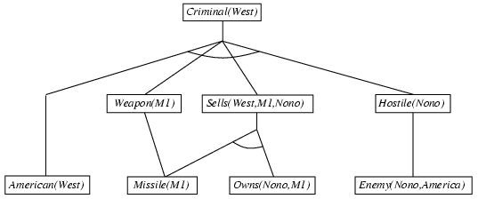
Forward chaining scheme

Slide 62

V. Backward chaining
Starts with a list of goal propositions and returns a set of substitutions fulfilling the goals.
Backward chaining example
What is the truth value of Criminal West? Is it true?

Slide 63
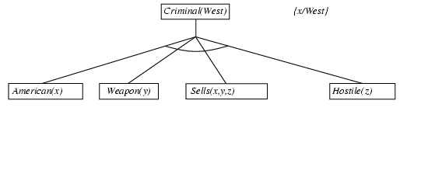
Backward chaining example

Slide 64
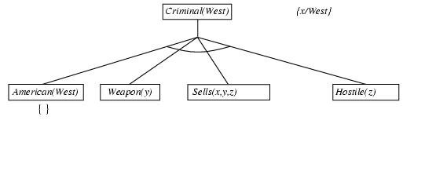
Backward chaining example

Slide 65
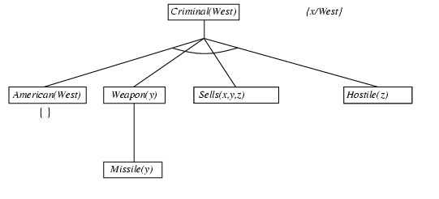
Backward chaining example

Slide 66
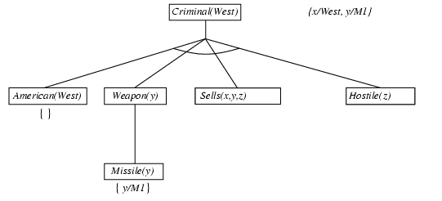
Backward chaining example

Slide 67
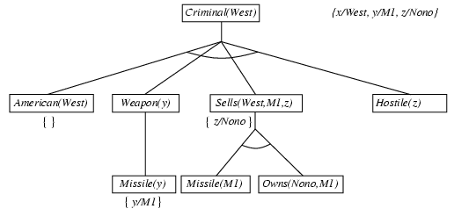
Backward chaining example

Slide 68
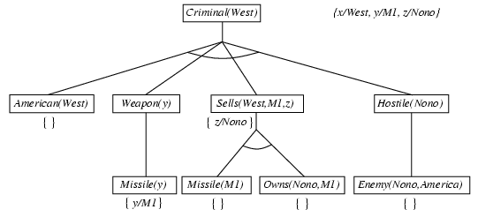
Backward chaining example

Slide 69
Backward chaining example
This substitution makes the premises satisfable.

Slide 70
VI. Resolution
Conjunctive normal form for FOL:
CNF: Conjunction of clauses of which each is a disjunction of literals.
Example:
CNF:

Slide 71
Conversion to the CNF
Example: Everyone, who loves all animals, is loved by someone.
Steps: 1. Implication elimination

Slide 72
Use rules for the quantifier negation.
So:

Slide 73
Variable standarization
If there is one name for different objects, variables, change it.
4. Scolemization (elimination of the existence quantifier)
Attention, bad scolemization

Slide 74
Correct scolmization:
5. Skip general quantifiers
Scolem functions

Slide 75
6. Rewrite on and final adjustments.
The sentence is in the CNF form, it is a conjunction of two disjunctions.

Slide 76
Rezolution:
Resolution proves that by contradiction,
by proving unsatisfability of

Slide 77
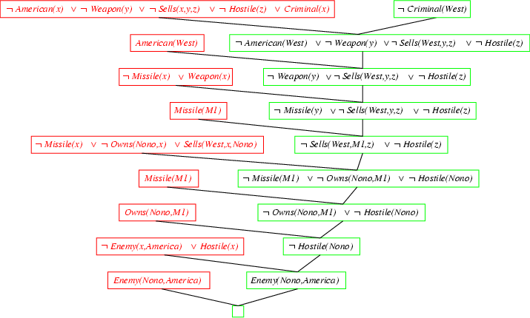
Resolution proof: definite clauses

Slide 78
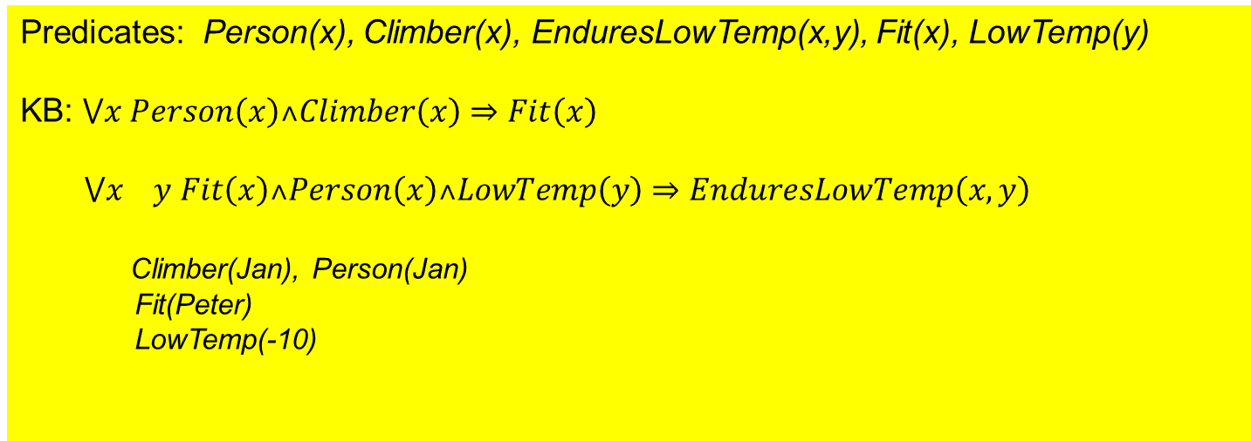
One more example from an exam
Situation: If a person is a climber then he is fit.
If a person is fit, then he endures low temperature.
Jan is a climber and person. Peter is fit. -10 C is a low temperature.
Prove that Jan endures low temperature -10 C.
Predicates: Person(x), Climber(x), EnduresLowTemp(x,y), Fit(x), LowTemp(y)
KB: $⋁x Person\left(x\right)˄Climber\left(x\right)⇒Fit\left(x\right)$
$⋁x y Fit\left(x\right)˄Person\left(x\right)˄LowTemp\left(y\right)⇒EnduresLowTemp\left(x,y\right)$
Climber(Jan), Person(Jan)
Fit(Peter)
LowTemp(-10)

Slide 79
Summary
Propositional KB, semantics, syntax
CNF forma
Inference methods in propositional KB, resolution, forward and backward chaining
FOL KB
Unification, substitution
Generalized inference methods in FOL KB

